Slide 1

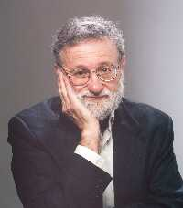
The Design of Everyday Things
Donald A. Norman

Slide 2
The psychopathology of everyday things
Doors
Light switches
Taps
Telephones
Microwaves
VCR’s

Slide 3
Affordances
“the perceived and actual properties of the thing, primarily those fundamental properties that determine just how the thing could possibly be used”

Slide 4
Affordances
Plates are for pushing
Knobs are for turning
Buttons are for pressing
No picture, label or instruction is required

Slide 5
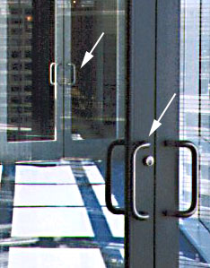
Doors are for opening

Slide 6
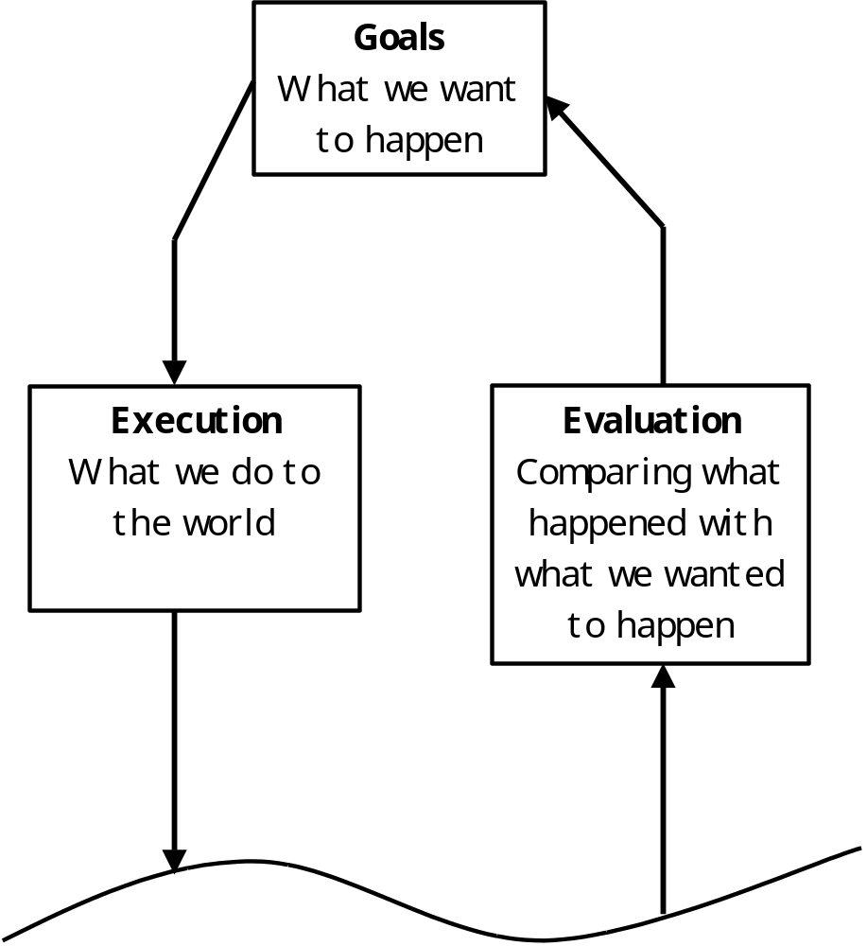
Norman’s Action Cycle

Slide 7
Norman’s Seven Stages of Action
Execution
Goals
Evaluation
Evaluation of interpretations
Intention to act
Sequence of actions
Interpreting the perception
Execution of the action sequence
Perceiving the state of the world
The World

Slide 8
The Gulf of Execution
The difference between the intentions and the allowable actions

Slide 9
The Gulf of Evaluation
Reflects the amount of effort that the person must exert to interpret the physical state of the system and to determine how well the the expectations and intentions have been met.

Slide 10
Principles of good design

Slide 11
Provide a good conceptual model
A conceptual model allows the user to simulate the operation of the device.
A good conceptual model allows the user to predict the effects of their actions.

Slide 12
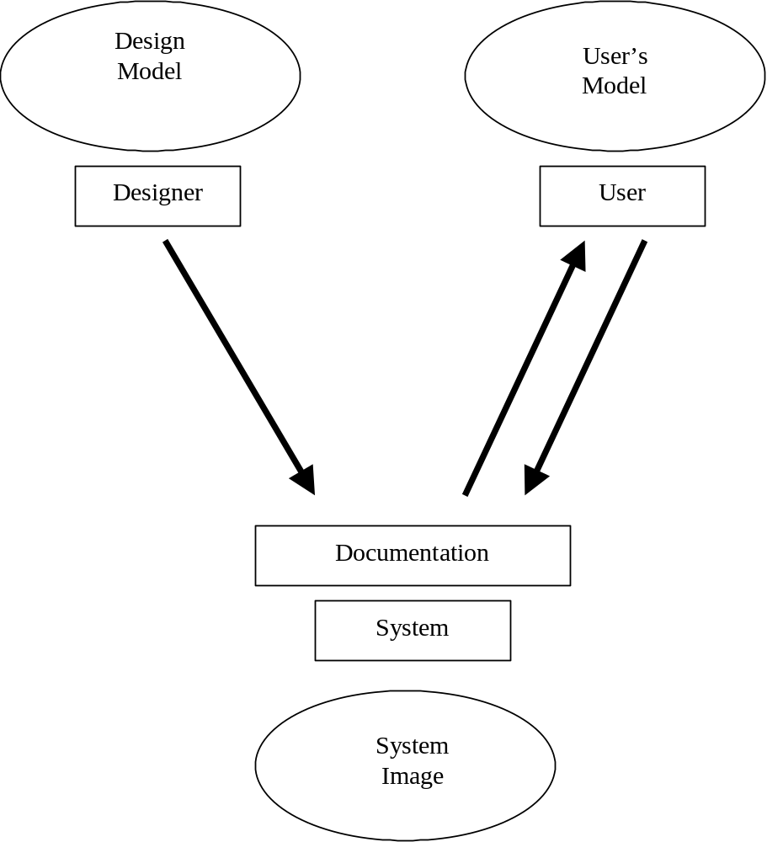

Slide 13
Make things visible
By looking, the user can tell the state of the device and the alternatives for action.
The telephone
The motor car

Slide 14
The Principle of Mapping
The relationship between two things
Natural mapping
  Physical analogies
  Cultural standards

Slide 15
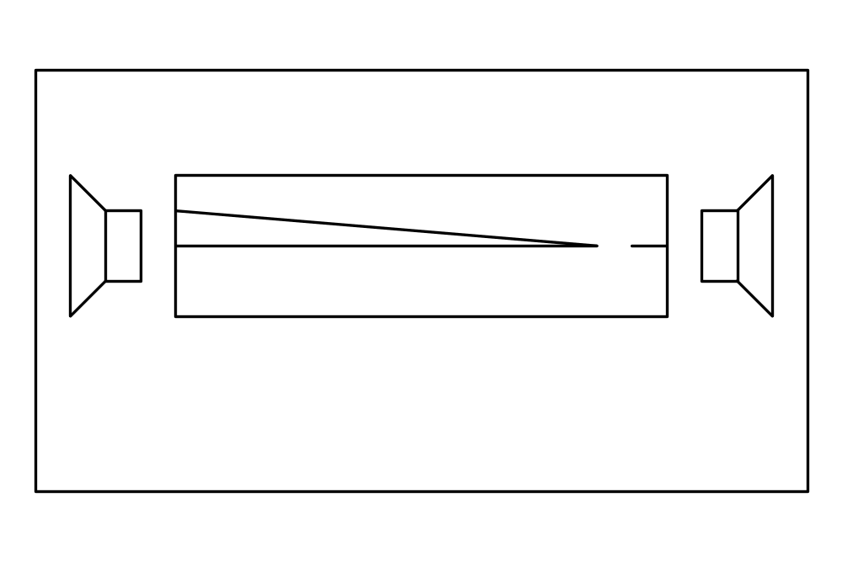
Car speaker control

Slide 16
Good mappings
It is possible to determine the relationships between:
  Actions and results
  Controls and their effects
  The system state and what is visible

Slide 17
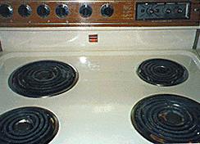

Natural mapping

Slide 18
The Principle of Feedback
Sending back information to the user on what has been done.
The user should receive full and continuous feedback about results of actions.
Example: Stationery ordering system

Slide 19
Conclusion
Things don’t have to be so hard to use.
Even the best-trained and best-motivated designers can go wrong when they listen to their instincts instead of testing their ideas on users.

